Slide 1

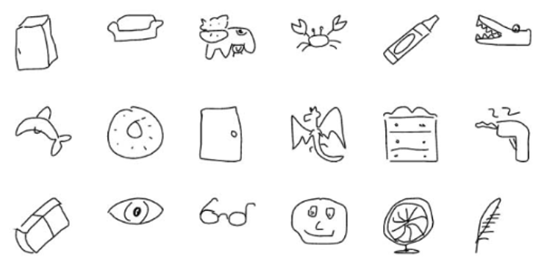
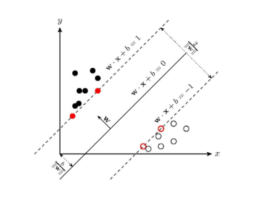
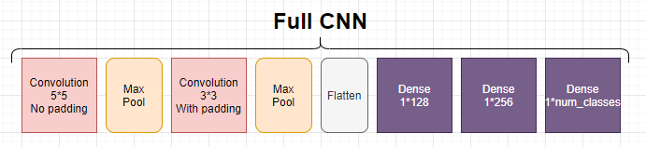
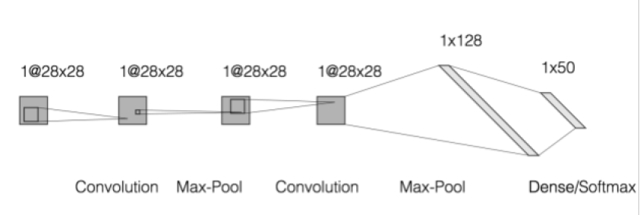
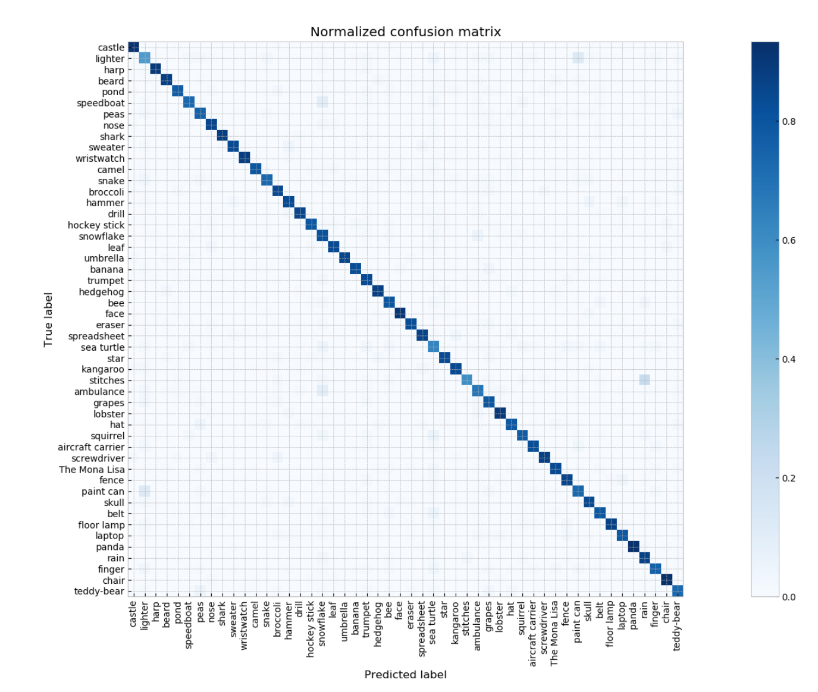
A Research on Sketching Recognition with Machine Learning Technologies
…
Problem
Contribution
Pattern recognition has become an important topic in machine learning. A specific topic in pattern recognition is sketch recognition, or in other word, recognition of hand writing. Recognition of hand drawing may help us to better understand the concepts from the particular implementation of machine learning and artificial intelligence.
Figure 1: Sample drawings collected from the Quick-draw date-set
We set up experiments with the Quick-draw data-set, then compare results to validate some previous works conducted by our colleagues in the field, as well as to explore the possibility to further improve efficiency.
By conducting experiments and comparisons, we are able to find out the optimized model for sketch recognition.
Methodology
K-nearest neighbours
K-Nearest Neighbor learning is, given a training sample, to find the nearest K training samples(“neighbors”) based on some measurements on distances, then predict the outcomes based on the information provided by the “neighbors”.
SVM (Support Vector Machine)
An example of a hyperplane and its support vectors
CNN(Convolutional Neural Network)
We extract features with the convolution layers, then determine the categories of the selected images with the dense layers.
SVM records all hyperplanes that were used to recognize in between any two different categories in the training data-sets, and outputs the category with highest probability based on all 1-vs-1 comparisons.
The structure of CNN we are using
Experiments and results
We applied the CNN (Convolutional Neural Network) and SVM (Support Vector Machine) models to train our data-sets, as well as applied data-set tests to check the correctness of pattern recognition by comparing statistics. We also compared the efficiency of aforementioned models.
SVM with different kernels:
Results obtained from comparing KNN(baseline), SVM and CNN:
A sample of a normalized confusion matrix for CNN with 50 classes:
 | 3 classes |  | 10 classes |  | 50 classes |  | 100 classes
Kernel | Accuracy | Training Time(s) | Accuracy | Training Time(s) | Accuracy | Training Time(s) | Accuracy | Training Time(s)
Linear | 75.75% | 45.2 | 65.81% | 336.9 | 42.79% | 6463.8 | N/A | N/A
Poly | 88.58% | 15.1 | 84.53% | 182.2 | 66.5% | 3907.5 | 59.80% | 13205.0
RBF | 88.29% | 14.1 | 83.17% | 150.2 | 63.27% | 3164.0 | 57.36% | 10769.9
Sigmoid | 65.19% | 37.8 | 50.39% | 453.7 | 29.94% | 8007.9 | N/A | N/A
The accuracy of SVM model is largely depending on the number of classes. Accompany by the increasing number of categories, different classes with almost the same distinguishing features, such as a hockey stick or a banana, are more likely to appear.
After some attempts on enlarging the training dataset, the best results on performance of RBF kernel reach 91.5% and 89.0% for 3 and 10 different symbols respectively.
From our results, both SVM and CNN models perform better than the KNN model which is our baseline. In the 100 classes trail, we used a smaller training set to train the CNN, which caused an accuracy lower than expected. However, The advantage of CNN is significant when dealing with large numbers of different doodles.
Reference
[1] Yu, Q., Yang, Y., Song, Y., Xiang, T., & Hospedales, T.M. (2015). Sketch-a-Net that Beats Humans. BMVC
[2] Andersson, M., Maja, A., & Hedar, S. (2018). Sketch Classification with Neural Networks : A Comparative Study of CNN and RNN on the Quick, Draw! data set.
[3] Bishop, Christopher M. (2006). Pattern Recognition and Machine Learning (Information Science and Statistics). Springer

